Slide 1
Chapter 2 Configuration Space
2.1 DOF of a Rigid Body
2.2 DOF of a Robot
Chapter 3 Rigid-Body Motions
Chapter 4 Forward Kinematics
Chapter 5 Velocity Kinematics and Statics
Chapter 6 Inverse Kinematics
Chapter 7 Kinematics of Closed Chains
Chapter 8 Dynamics of Open Chains
Chapter 9 Trajectory Generation
Chapter 10 Motion Planning
Chapter 11 Robot Control
Chapter 12 Grasping and Manipulation
Chapter 13 Wheeled Mobile Robots

Slide 2
Important concepts, symbols, and equations
configuration: a specification of the positions of all points of a mechanism
degrees of freedom (dof): # of real #s required to describe a configuration
configuration space (C-space): the dof-dimension space of all configurations
dof of a planar body: m = 3; dof of a spatial body: m = 6

Slide 3
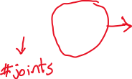

Important concepts, symbols, and equations (cont.)
mechanism dof = Σ (body freedoms) – Σ (independent constraints from joints)
joint types:
Grübler’s formula:
dof

Slide 4

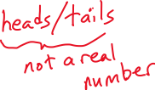



coin on a plane
coin in space

Slide 5



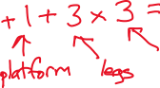
3 x PPRS parallel
manipulator
S
P
R
P
KUKA Systems North America LLC
(patent pending)

Slide 6



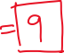



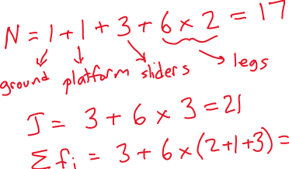
S
P
U
P

Slide 7

3 x PUU miniature surgical parallel manipulator
(National University of Singapore)

Slide 8




Quanser Hexapod
R
R
R
R
R
R
R
R
P
P
https://www.youtube.com/watch?v=AyVu4AE25DM

Slide 9
How many dof does the human arm have?
Method 1: add dof of joints (shoulder, elbow, wrist)
Method 2: fully constrain hand’s position
How many total constraints are imposed by
the joints?

